Slide 1
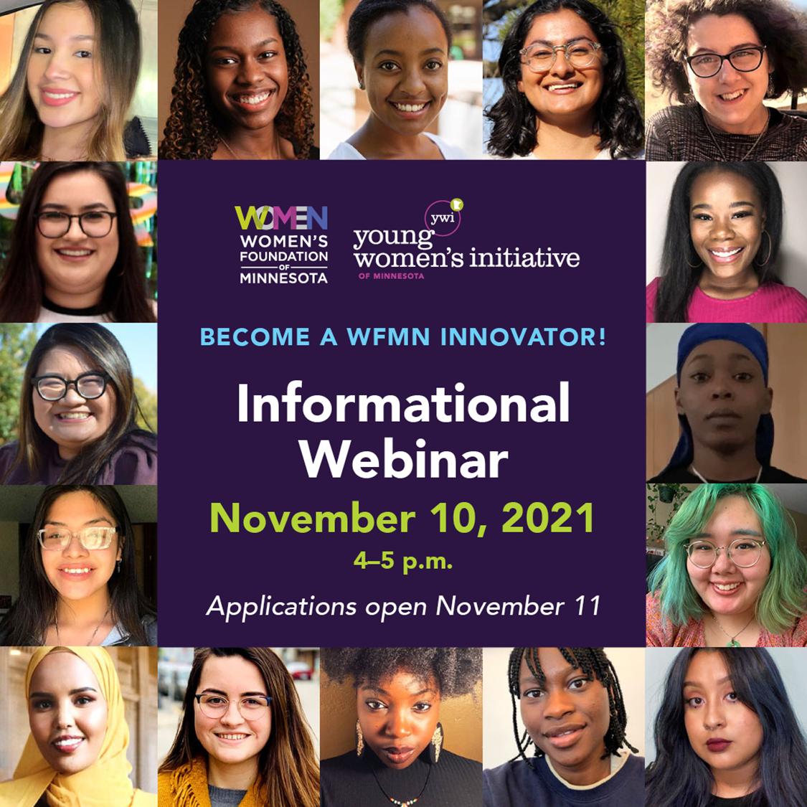
Welcome!
The webinar will start shortly.
Please stay on mute until the end. Any technical issues, please let us in the chatbox.
Ask questions in the chatbox
Notes:
Show flow in the beginning as people enter
PLAY MUSIC: https://open.spotify.com/playlist/4kfK9upmzhISFeUCDzthyA

Slide 2
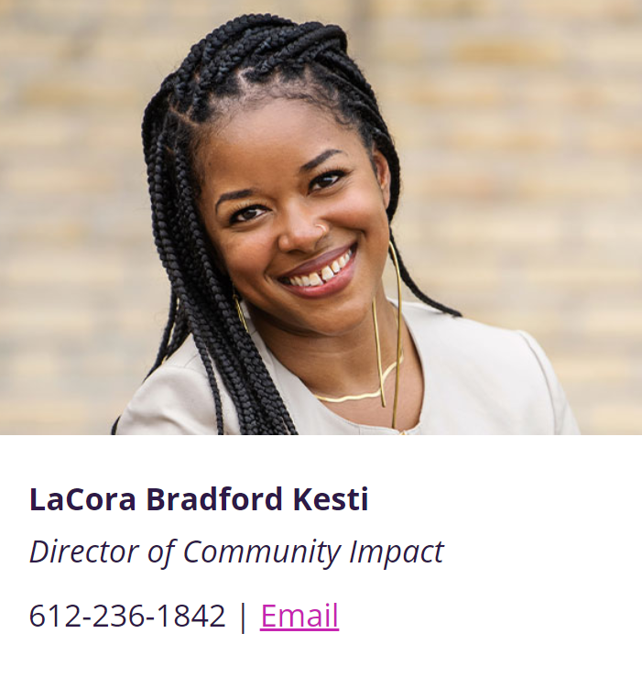
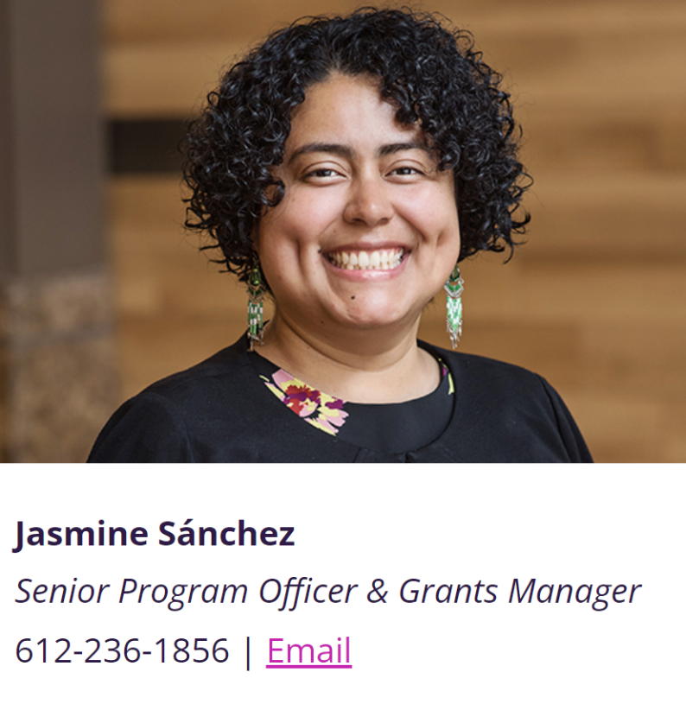
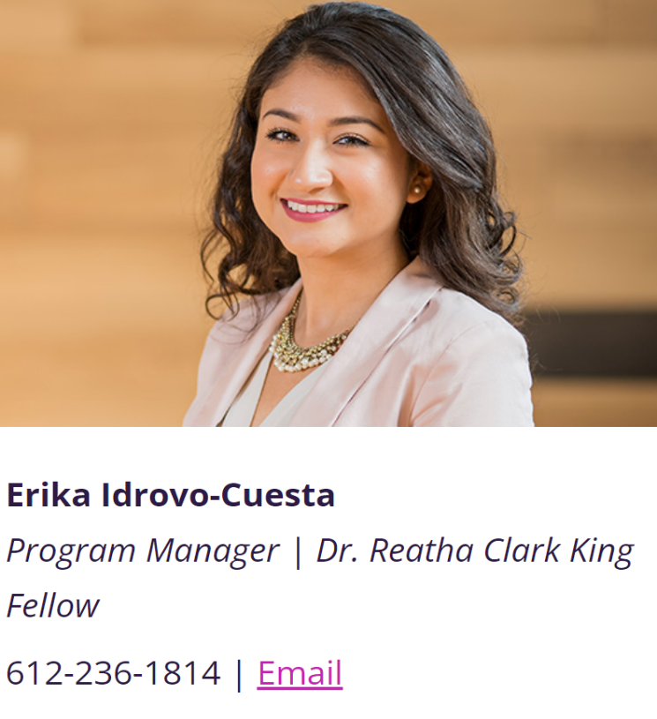
Meet WFMN Staff!
lacora@wfmn.org
jasmine@wfmn.org
erika@wfmn.org
Notes:
LaCora
Welcome everyone. My name is….
And this meeting is being recorded. If you wish to not be in the recording, you can have your camera off. We have live captioning available, the toolbar, click closed captioning. I will now let me collegues introduce themselves.

Slide 3
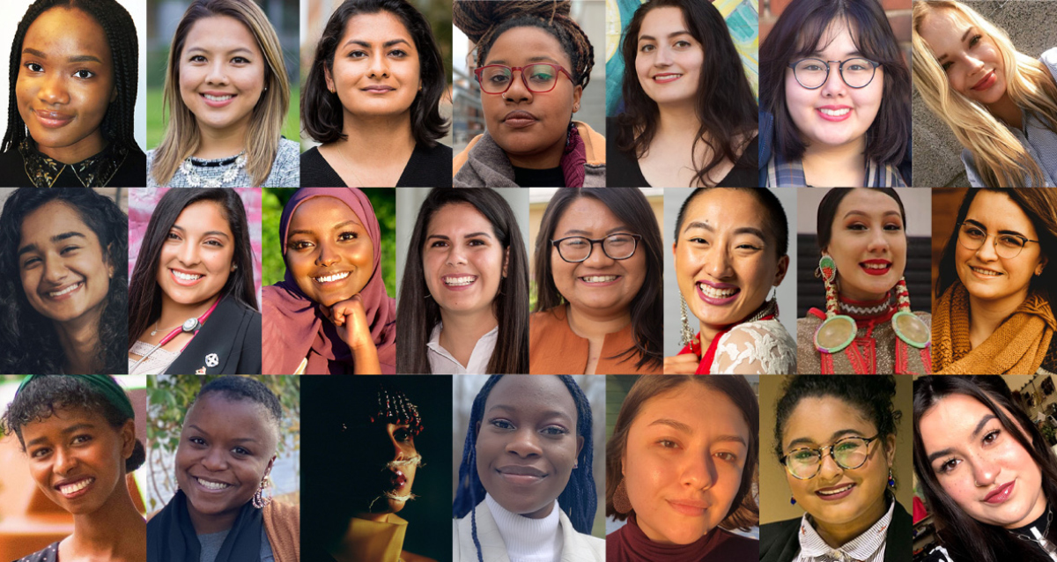
Webinar Overview
Offer information about the Women’s Foundation of Minnesota and the Young Women’s Initiative
Provide an overview of the WFMN Innovator program
Review application components, online web portal process, and timeline
Answer any questions
Notes:
LaCora
In this webinar today (Read Slides)

Slide 4
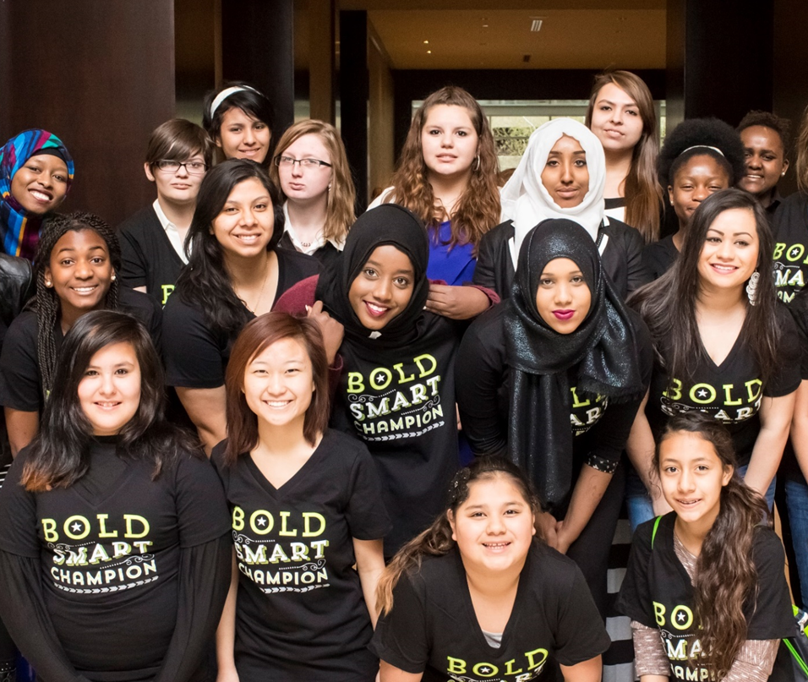
Women’s Foundation of Minnesota
MISSION
A statewide community foundation investing in innovation to drive gender and racial equity.
VISION
Create a world of equal opportunity where women and girls – and all people – hold the power to create safe, prosperous lives.
VALUES
Hope
Generosity
Inclusion
Notes:
Erika
To provide some context, at the Women’s Foundation of Minnesota, we are a statewide community foundation, and we are really committed to driving gender and racial equity. We have been working with partners all over Minnesota, for 38 years and we envision a world where women and girls, and all people hold the power to create safe and prosperous lives.
As a community foundation, our work extends to communications, grantmaking, fundraising, policy and research. Within this work, we lead with the values of hope, generosity and inclusion.
And we are really aim to make sure our relationships with participants, young women leaders, our grantee partners, and facilitators also reflect those values.

Slide 5
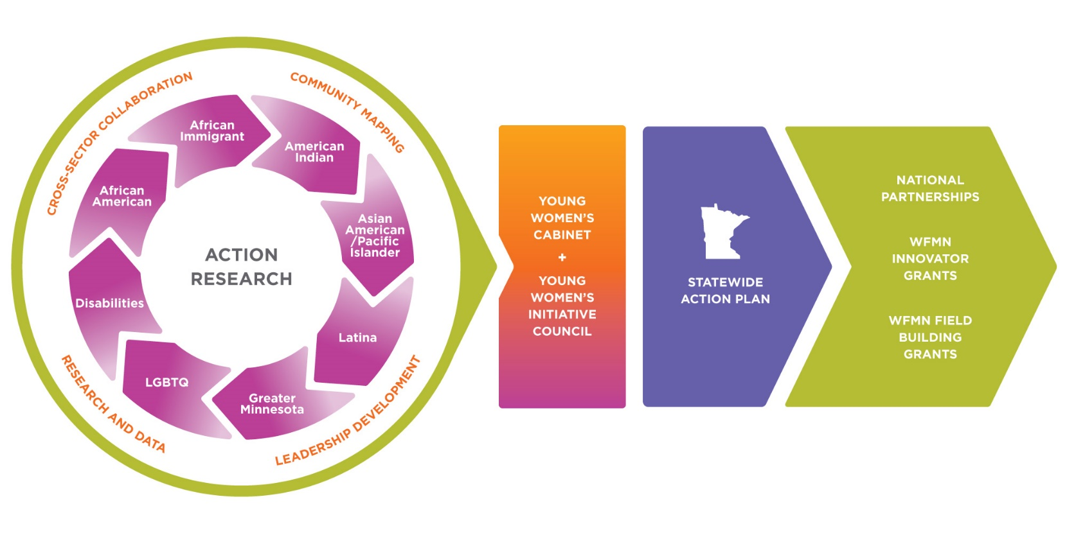
Young Women’s Initiative of Minnesota
A New Statewide Model to Create Equity
Notes:
So what is the Young Women’s Initiative of Minnesota? In partnership with the Governor’s Office in 2016, we launched the Young Women’s Initiative of Minnesota, as a multi-year, multi-million-dollar investment that centers the leadership and solutions of young women of color, American Indian young women, young women from Greater Minnesota, LGBTQ+ youth, and young women with disabilities.

Slide 6

20 Recommendations Informed by 800+ Young Women
Notes:
Erika
Drop in chat the Blueprint for Action report: https://5hmu22w0slizp30doyr8p14u-wpengine.netdna-ssl.com/ywi-mn-blueprint.pdf
Erika
So how did we start? Recognizing that problems and solutions are found in the same place, we know hearing directly from young women and youth is an important part of finding solutions. So we started with listening. In 2016, we convened listening sessions featuring young women and advocates from distinct communities and these sessions enabled each community to form its own panels to allow for deeper conversations around economics, racism and culture, school and education, societal and gender norms, safety, and health.
Then in 2017, we engaged deeper in this work, and started a community action research process, in partnership with the University of Minnesota Urban Research and Outreach-Engagement Center, we invited over 800 young women and community members from eight culturally specific communities across Minnesota, which were: community members that identify as African American, African Immigrant, American Indian, Asian American and Pacific Islander, Latina, LGBTQ+ (lesbian, gay, bisexual, transgender, queer), young women with disabilities, and young women in Greater Minnesota.
This work resulted in the YWI MN Blueprint for Action Report, that includes 20 data-driven and actionable recommendations built upon the tremendous community and cultural strengths young women and gender-expansive leaders already possess. We heard from Minnesota’s young women, that they are leaders, resourceful, innovative, entrepreneurial, role models, and pillars of their families and communities.
the Blueprint for Action, informed us and our partners in this work the need to create the Innovator’s program.

Slide 7
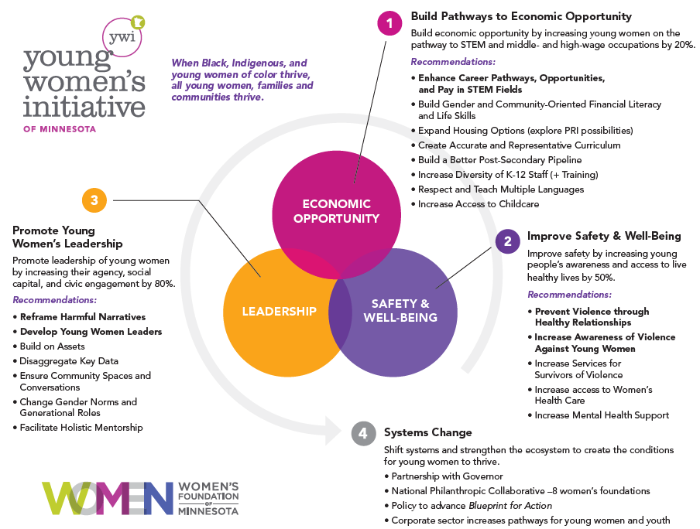
Notes:
Erika
Following the action research, we learned that the following solutions and goals of action are necessary for young women to thrive which are: building pathways to economic opportunity, improving safety & well-being, and promoting young women’s leadership. These three goals work together to shift systems and strengthen the ecosystem to create the conditions for young women and communities to thrive using a systems change model.

Slide 8
Process of Systems Change & Shifts
Direct Services
Change in individual behavior unrelated to social action of change in the broader community
Social / Systems Change
Increases access to equal opportunities and equity in outcomes.
Shifts in…
Institutions, laws or policies
Community or individual behavior
Definition or reframing of issues
Engagement / Movement-Building
Maintaining or holding the line
Direct Services
Supports individuals; may or may not relate to broader community or systemic change.
Notes:
The young women’s initiative is a systems change model, grounded in the voices and experiences of young women from 8 specific communities. It stem from listening, going around the state and asking young women themselves, hey what are your hopes and dreams and what are the barriers that are standing in your way as you live your day to day life.
Systems change work increases access to equal opportunity and equity in outcomes. And it supports individuals. As a WFMN Innovator, you and your projects, are shifting institutions, laws, policies, by reframing issues through community relationships and movement building. (Next slide)

Slide 9
“There is no such thing as a single-issue struggle, because we do not live single-issue lives.”
— Audre Lorde
Notes:
And I love love love this quote by Audre Lorde, “There is no such thing as a single issue struggle, because we do not live single-issue lives.” This quote I think sums the purpose and it speaks to why the Young Women’s Initiative & the Innovator program are so needed today. It calls out for the needs of communities living with intersecting identities, and that the term women is not so generalized. It brings attention to these solutions addressing racial and gender inequities, making it possible to dream of state where all women can thrive when we consider the intersection of communities. And with that, I want transition us now to the overview the Innovators program (next slide)

Slide 10
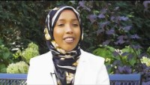
        Hilal Ibrahim, Founder & CEO, Henna & Hijabs
        2018-19 WFMN Innovator
Notes:
Erika:
By sharing a story from one of our former Innovator’s, Hilal Ibrahim, who was part of the first program year in 2018, where she used her project to develop her business, Henna & Hijabs.
Jasmine drop business link: https://hennaandhijabs.com/

Slide 11
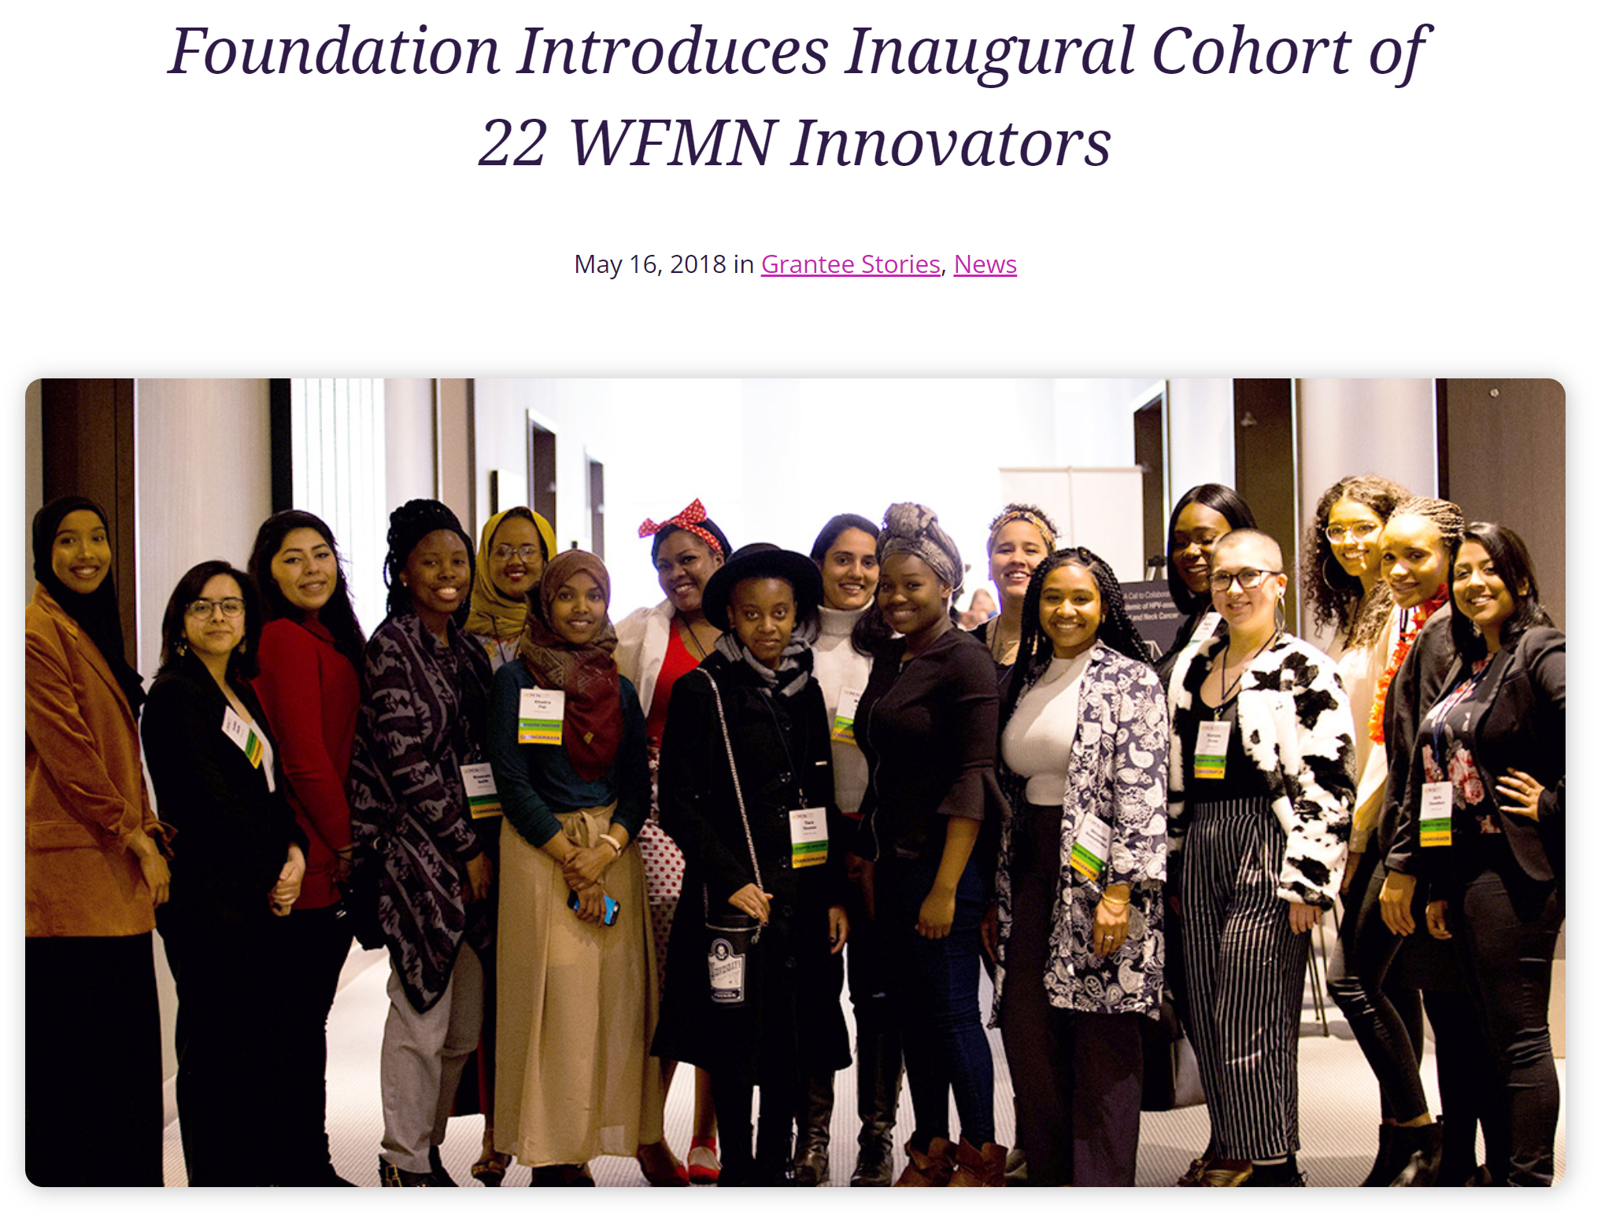
WFMN Innovator Program
Launched in 2018
Ages 16-24
One-time $2,500 grant
Advance key recommendations of YWI MN + Blueprint for Action Report
Program consists of:
  Leadership development
  101 Coaching
  Convenings and trainings
Notes:
LaCora?
The Innovator program launched in 2018, to invest in young women ages 16-24, whose leadership, ideas, and solutions advance key recommendations in the Young Women’s Initiative of Minnesota (YWI MN), Blueprint for Action. Each WFMN Innovator was awarded a one-time $2,500 grant to lead this work.
Each quarter, WFMN will engage the cohort in leadership development, advocacy opportunities, and community building to scale their leadership and project impact.
Program consists of:
Leadership development
101 Coaching
Convenings and trainings

Slide 12
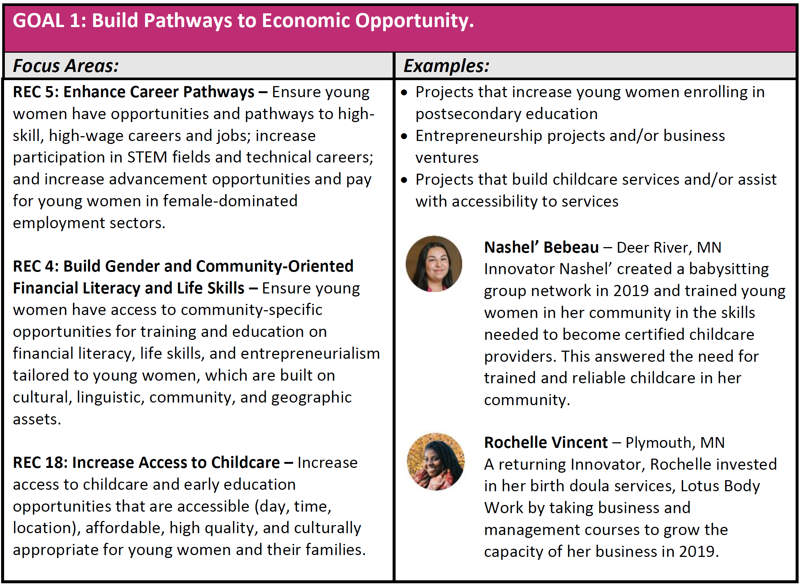
2022-2023
WFMN
Innovator
Program
Year Focus
One key goal and address one or more focus areas
Notes:
LaCora talk through Program Focus
Your project should further one of the key goals of the Young Women’s Initiative. Within each goal, your project should encompass one or more of the following Blueprint for Action recommendations focus areas:
Erika Drop Preview Worksheet
WFMN Innovator Grant Guidelines And Application Preview Worksheet: https://5hmu22w0slizp30doyr8p14u-wpengine.netdna-ssl.com/wp-content/uploads/2021/11/WFMN-Innovator-Grant-Guidelines-and-Application-Preview-Worksheet.pdf

Slide 13
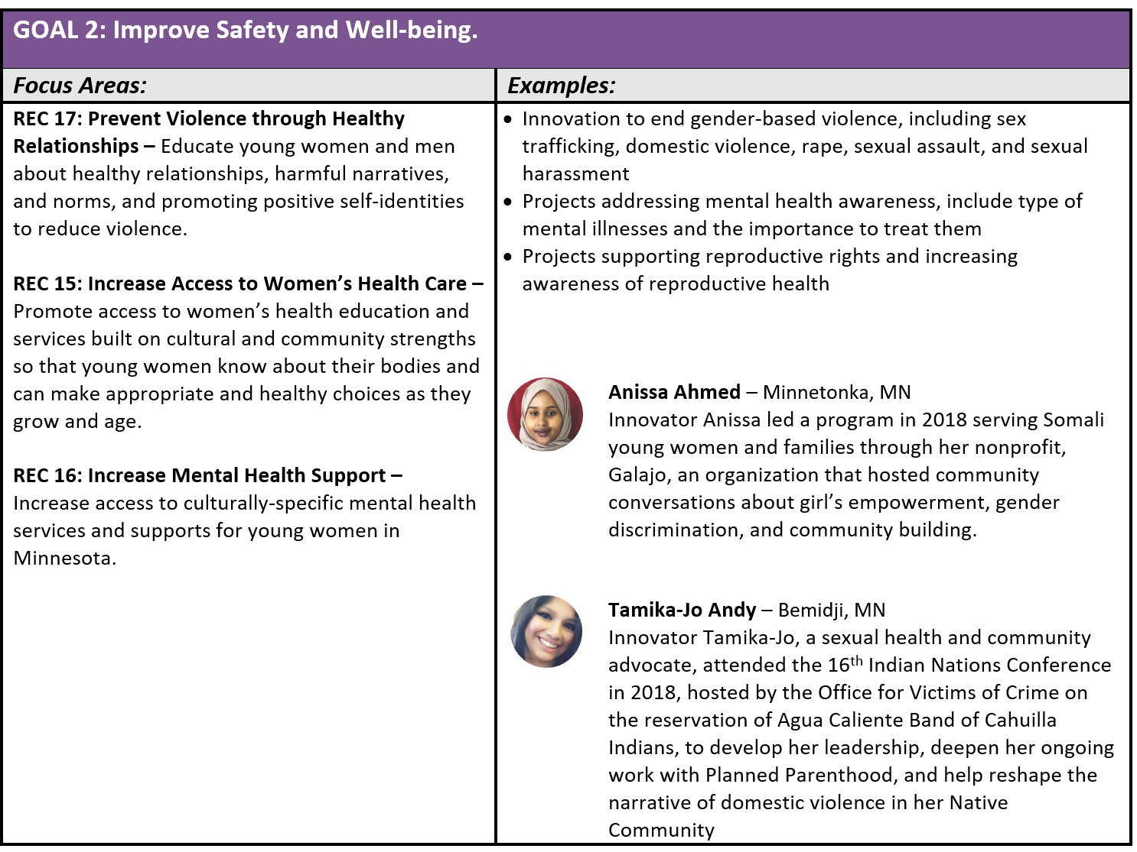
2022-2023
WFMN
Innovator
Program
Year Focus
One key goal and address one or more focus areas
Notes:
LaCora talk through Program Focus
Your project should further one of the key goals of the Young Women’s Initiative. Within each goal, your project should encompass one or more of the following Blueprint for Action recommendations focus areas:
Erika Drop Preview Worksheet: https://5hmu22w0slizp30doyr8p14u-wpengine.netdna-ssl.com/wp-content/uploads/2021/11/WFMN-Innovator-Grant-Guidelines-and-Application-Preview-Worksheet.pdf

Slide 14
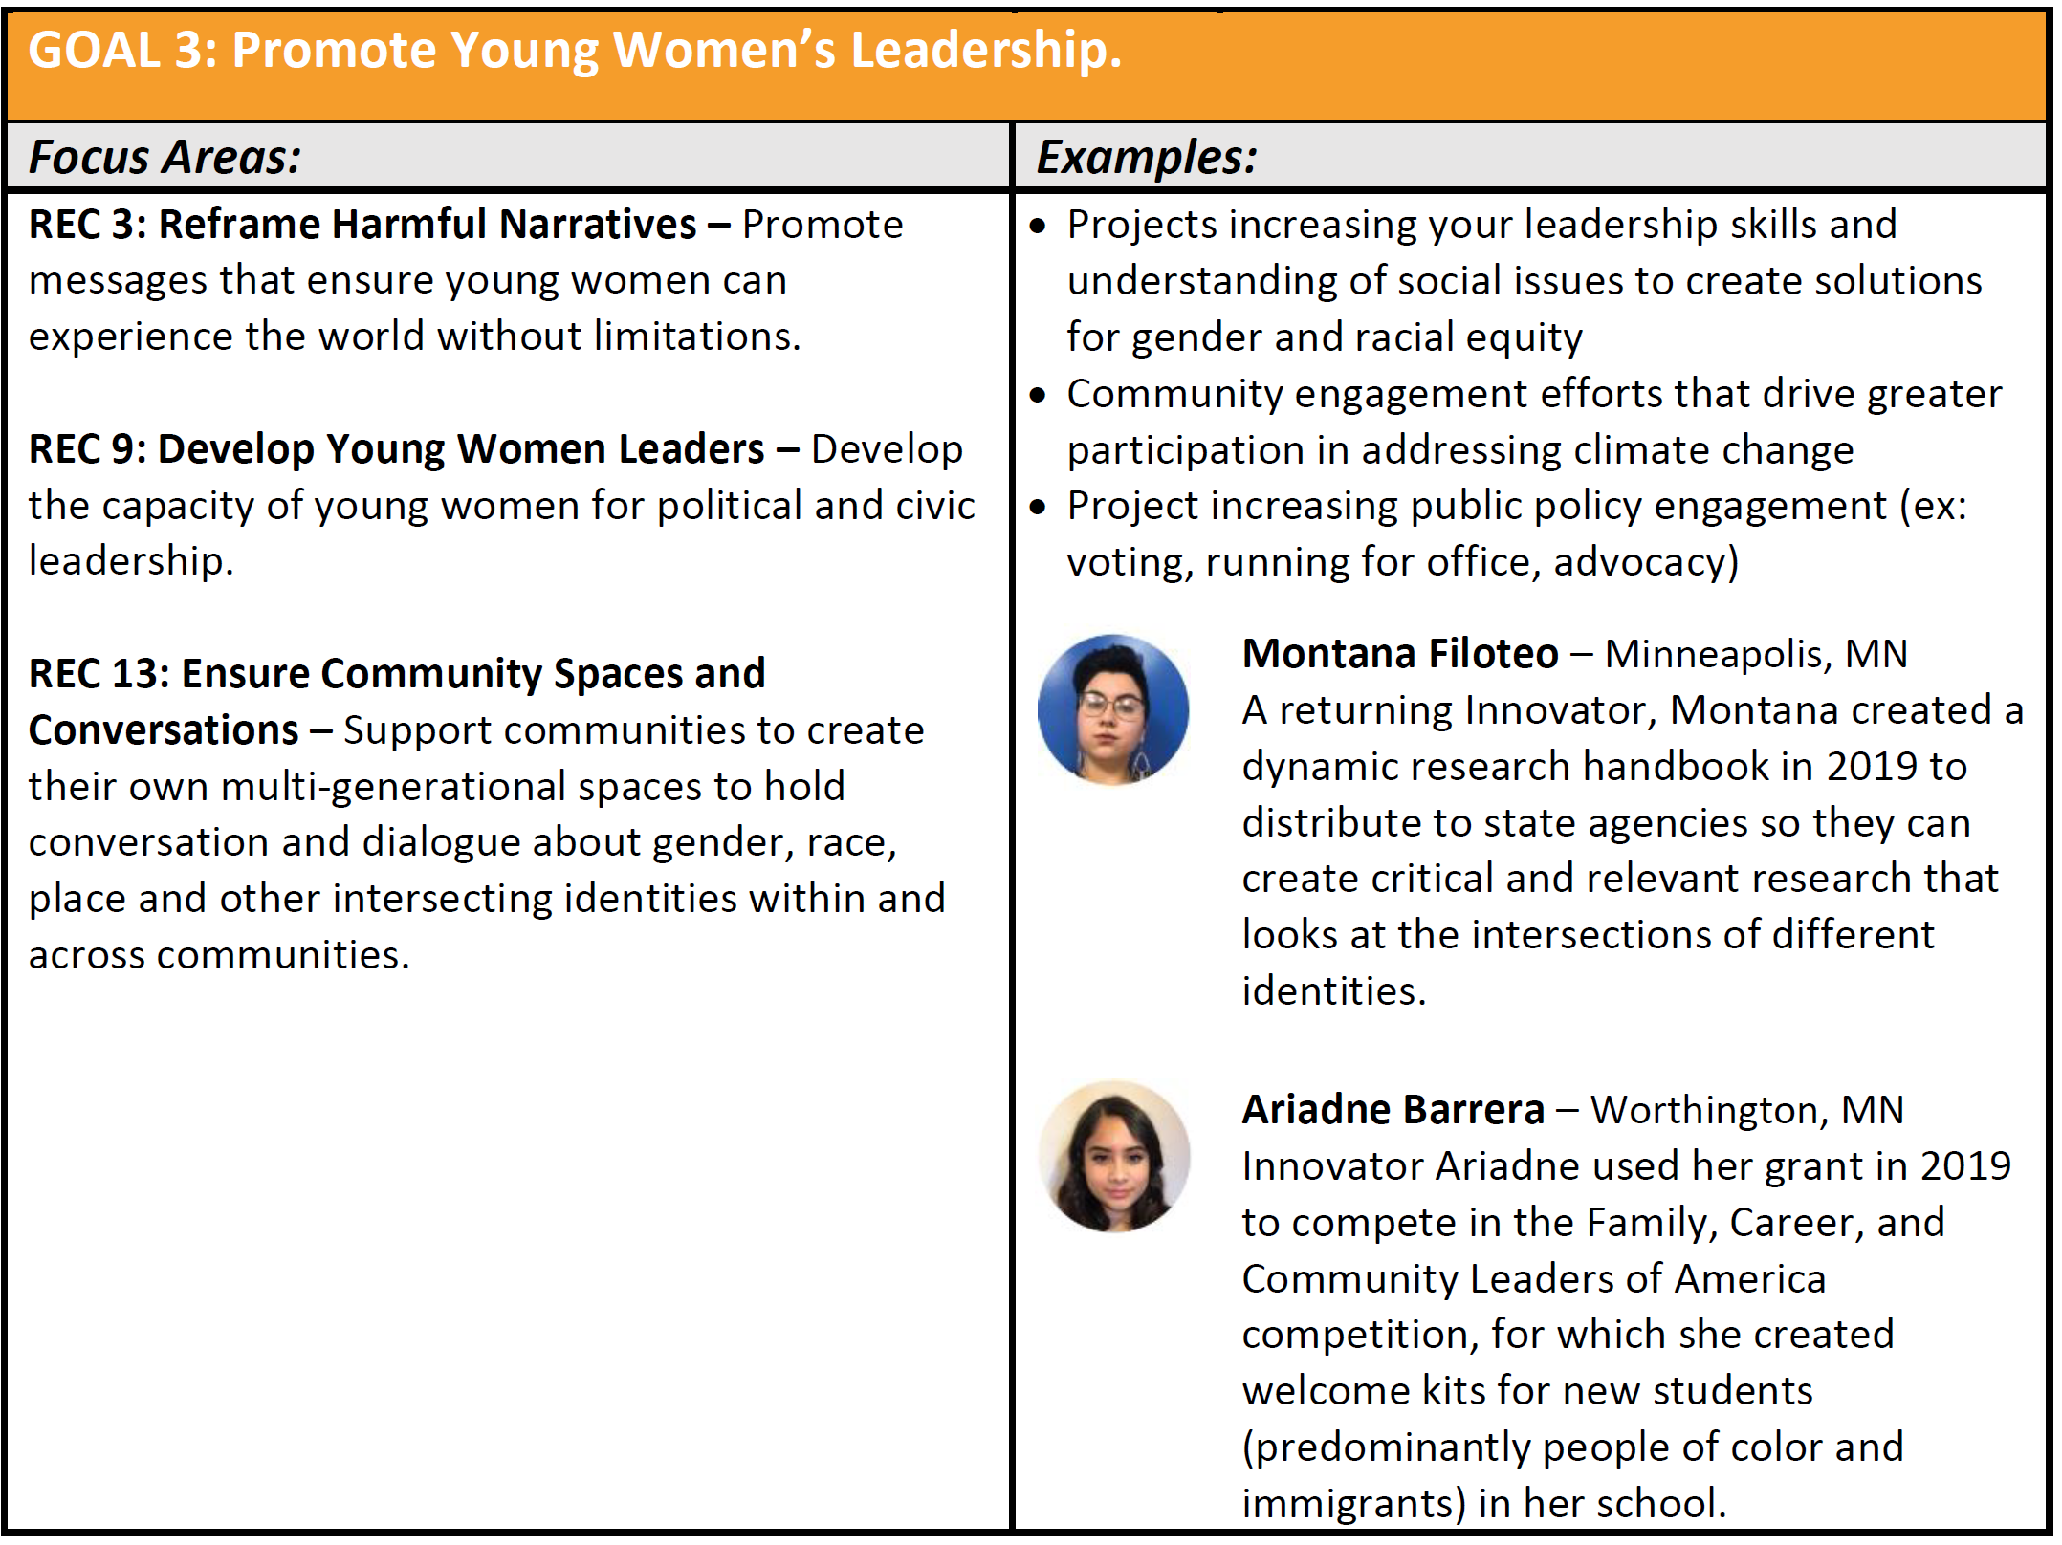
2022-2023
WFMN
Innovator
Program
Year Focus
One key goal and address one or more focus areas
Notes:
LaCora talk through Program Focus
Your project should further one of the key goals of the Young Women’s Initiative. Within each goal, your project should encompass one or more of the following Blueprint for Action recommendations focus areas:
Erika Drop Preview Worksheet: https://5hmu22w0slizp30doyr8p14u-wpengine.netdna-ssl.com/wp-content/uploads/2021/11/WFMN-Innovator-Grant-Guidelines-and-Application-Preview-Worksheet.pdf

Slide 15
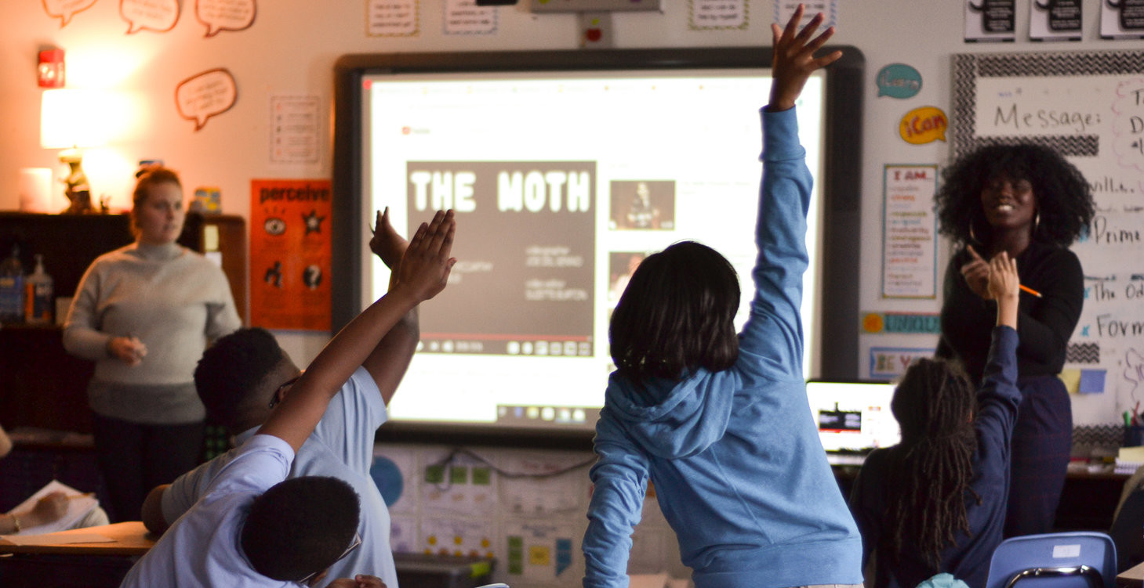
Eligibility & Grant Guidelines
GRANT TYPE
Monetary Investment – $2,500: Investment in the leadership, ideas, and initiatives of young women and gender-expansive leaders to bring their Blueprint for Action ideas to life or continue their work in the areas of economic opportunity, safety, and leadership.
EXAMPLES
• Start or continue a social change initiative
• Design and pursue a personal learning plan
• Attend a conference and share learnings with community for impact
• Organize an event for impact
• Supply resources to organize people for advocacy
• Research
• Travel as part of greater learning and share learnings in Minnesota for impact
Notes:
LaCora:
GRANT TYPE
Monetary Investment – $2,500: Investment in the leadership, ideas, and initiatives of young women and gender-expansive leaders to bring their Blueprint for Action ideas to life or continue their work in the areas of economic opportunity, safety, and leadership.
WFMN encourages you to think creatively: How can this microgrant uniquely help move your leadership and ideas forward? How can it help you be more effective in the impact you want to make? Examples of projects could be executed in the following ways:
• Start or continue a social change initiative
• Design and pursue a personal learning plan
• Attend a conference and share learnings with community for impact
• Organize an event for impact
• Supply resources to organize people for advocacy
• Research
• Travel as part of greater learning and share learnings in Minnesota for impact

Slide 16

Eligibility & Grant Guidelines
ELIGIBLE APPLICANTS
• Identify as a young woman or gender-expansive person between the ages of 16 years old to 24 years old.
• Residence and impact in Minnesota.
• Priority given to young women identifying with one or more of the following communities: Black/African American, African Immigrant, American Indian, Hispanic/Latina, Asian/Pacific Islander, LGBTQ+, Disabilities, Greater/Rural Minnesota.
• Citizenship is not required.
PARTICIPATION
Leadership Convenings & Coaching – WFMN will engage young women in mandatory online and/or in-person convenings for leadership development, advocacy, and building community.
GRANT TERM
The funds must be used within 12 months.
GRANT REPORTING
Create a video of project and experience and engage in evaluation process.
*Our definition of young woman is anyone who identifies as a woman and is inclusive of cisgender, transgender, gender non-conforming, and gender non-binary people.
Notes:
LaCora
The Women’s Foundation of Minnesota will accept applications from eligible applicants in the state of Minnesota which include the following:
Identify as a young woman or gender-expansive person between the ages of 16 years old to 24 years old.
Our definition of young woman is anyone who identifies as a woman and is inclusive of cisgender, transgender, gender non-conforming, and gender non-binary people.
Residence and impact in the state of Minnesota for the entire grant period.
Priority given to young women identifying with one or more of the following communities: Black/African American, African Immigrant, American Indian, Hispanic/Latina, Asian/Pacific Islander, LGBTQ+, Disabilities, Greater/Rural Minnesota.
Citizenship is not required.
PARTICIPATION
Leadership Convenings & Coaching – WFMN will engage young women in mandatory online and/or in-person convenings for leadership development, advocacy, and building community. The convenings will give young women an opportunity to support, develop, and scale their leadership and ideas. This leadership development includes direct professional coaching to support Innovators in their grant-funded projects and to deepen their leadership for the long term.
GRANT TERM
The funds must be used within 12 months.
GRANT REPORTING
Each Innovator is responsible for executing their community project, meeting with their coach, and attending all convenings. Innovators will produce a project timeline and work with their coaches to execute the work. At the end of the cohort experience each Innovator will create a video of their project and experience. Additionally, Innovators are required to participate in a learning and evaluation process that will include surveys and interviews to share in depth their project learnings.

Slide 17
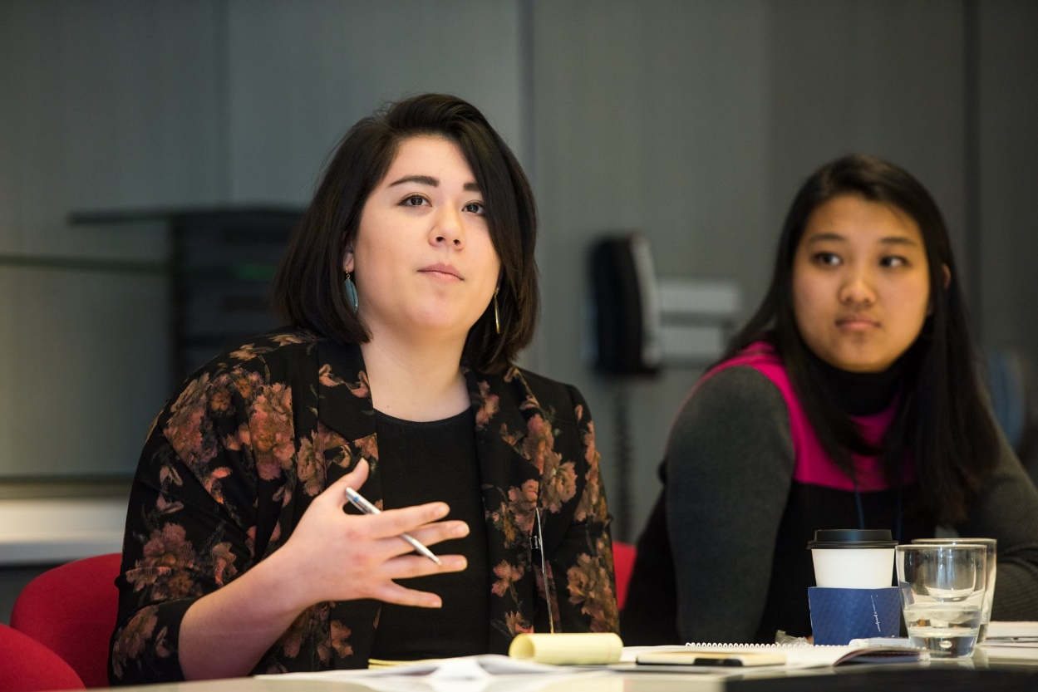
Eligibility & Grant Guidelines
SELECTION CRITERIA
Ability to identify their voice, share their lived experiences, and demonstrate commitment to community-building and leadership
Complete application submission
Review panel of young women and YWI MN partners
Notified by March 2022
Notes:
LaCora
Selection of WFMN Innovators will be based on applicants’ ability to identify their voice, share their lived experiences, and demonstrate commitment to community-building and leadership. Means complete application and meeting the YWI MN Goals.
The Women’s Foundation of Minnesota will engage a review panel of young women and YWI MN partners. The panel will review the grant proposals and recommend awards for the applications that best represent the mission, goals, and values of the Young Women’s Initiative of Minnesota. Applicants will be notified in March of 2022.

Slide 18


How to Apply, Application Components, & Timeline
Notes:
Erika

Slide 19
Application Components
How to Apply
Applicant Information & Project Information
Project Proposal Narrative
Project Budget & Optional Items: Resume, Photos, Website, etc.
Online application
Use Preview Worksheet to draft answers
Create account in web portal
Do not wait last minute!
Notes:
Erika:
All applications must be submitted online. Applicants are encouraged to use the worksheet below to preview and draft answers to the application questions.
To start your application, please create an account in our online web portal.
Please Do not wait last minute.
If there are any questions or accessibility issues to applying online, please let me know, and we can work out a solution.
The application components are: (1) Applicant Information & Project Information, (2)Project Proposal Narrative, and (3) Project Budget and Optional Items to help describe your project.

Slide 20

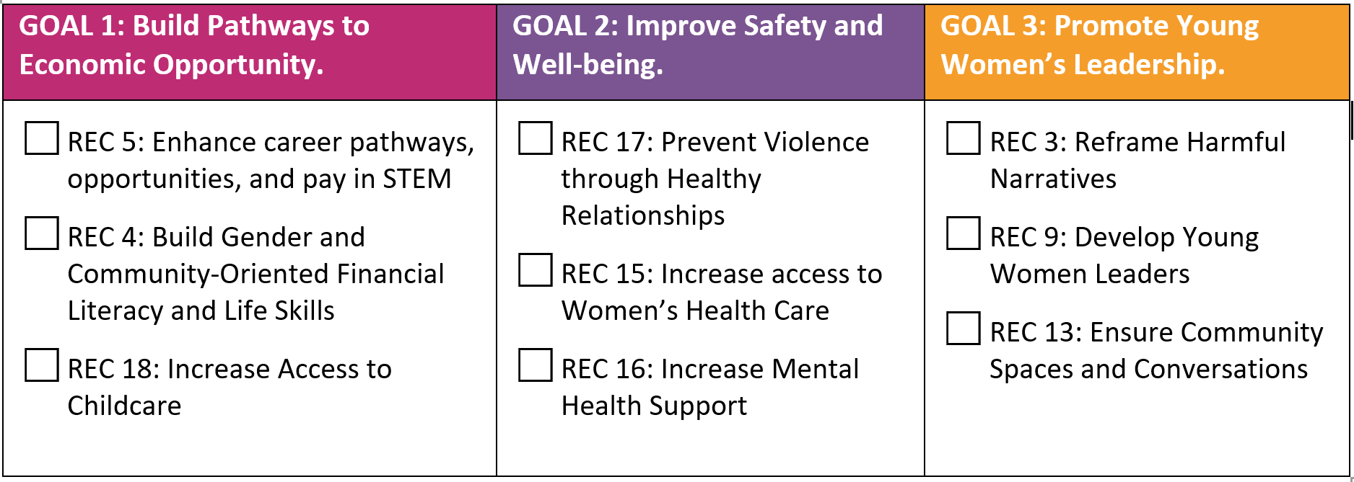
Your information
Project name & timeline
Which Blueprint for Action recommendation(s) is your project addressing? (Select one goal and check all that apply under that one goal):
Applicant Information & Project Information
Notes:
Erika

Slide 21

Project Proposal Narrative
Select ONE option to answer the project proposal narrative questions. Answers to each questions are required for a complete application:
Option 1: Video Submission
1-minute to 3-minute video and uploading it to a Dropbox folder. Applicants will not be judged on the technical quality of their video; however, visual and audio quality must be easy to understand and address each narrative question.
Option 2: Essay Submission
Submit answers in an essay format for each question.
1. Tell us about you!
What life experiences made you the leader that you are today?
2. Tell us about your community!
With which community or communities do you identify? How do you demonstrate leadership to create change in your community?
3. Tell us about your vision!
What are the challenges faced by your communities? What is the change you seek and the vision you have for you and your community?
4. Project Description
Include a short description of the project. Why is it needed, what are potential challenges, who will be involved (population serving and age groups), desired results, and outcomes, and who will benefit.
5. Project Goals
How does your project advance gender and racial equity? How does this project align with the Blueprint for Action Recommendations?
6. Project Tracking
How will you ensure accountability, communication, and evaluate your successes and learnings throughout your project?
Notes:
Erika
Read through options to answers the narrative questions
Read questions and explain each part

Slide 22

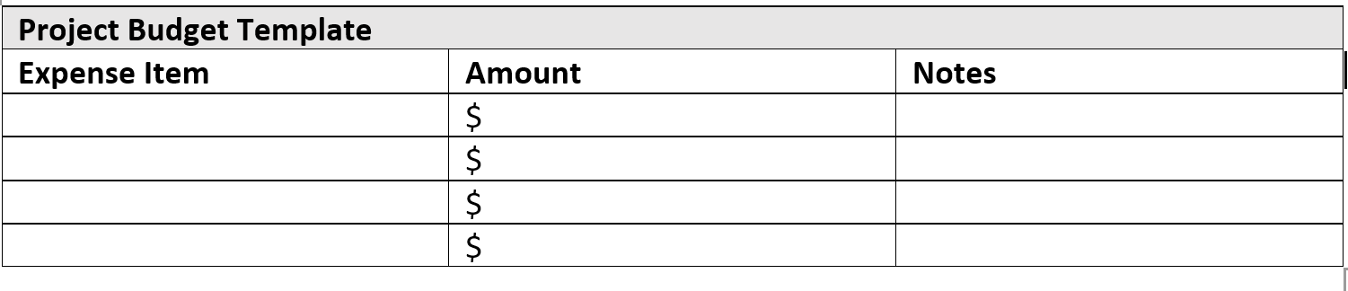
Upload attachments in online application
Project Budget is required. All expenses should add up to $2,500
Project Budget & Optional Items: Resume, Photos, Website, etc.
Notes:
Erika
Project budget is required. We want to know you have something planned for the grant expenses. But We recognize projects are fluid and this exercise is meant as a template for your planning. If selected, your WFMN Coach can provide more support on how to best leverage your funds to execute your project. Add notes and rows as needed. All expenses should add up to $2,500.
Optional: Resume and photos or website that help to describe the project. SO if you are planning a conference, or going to one and using the funds to support you in covering those expenses, you can upload a informational document on the conference, and estimate the costs for it you to attend the conference.

Slide 23
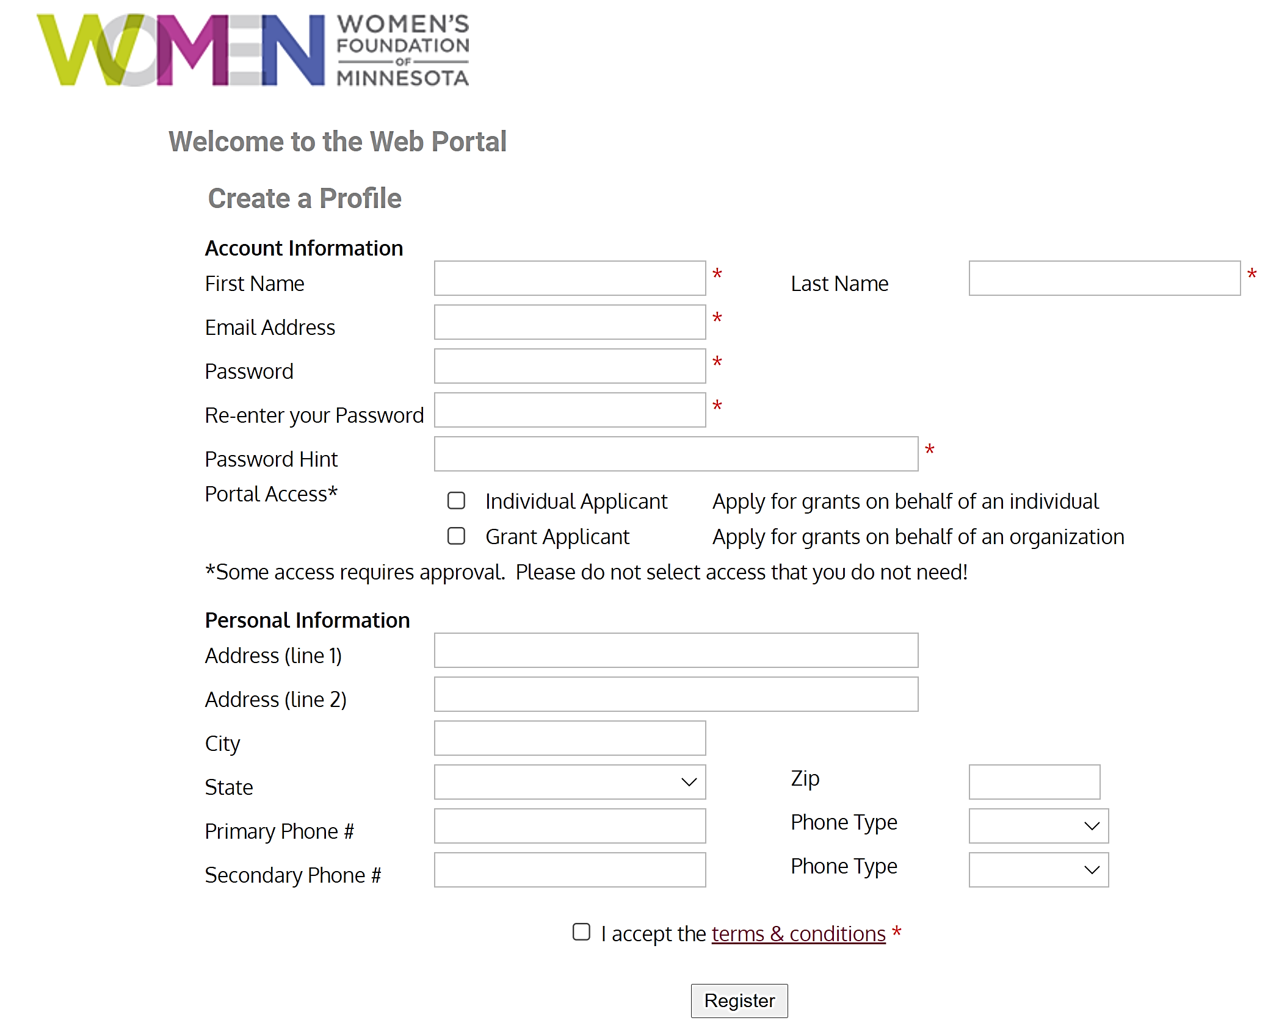
https://wfmn.spectrumportal.net/Accounts/Register
Web Portal Registration
First time users
Use Google Chrome
or Firefox as browser
Select
Individual applicant
Accept terms &
conditions
Notes:
Jasmine:
Drop link: https://wfmn.spectrumportal.net/Accounts/Register
Your registration will prompt an authentication by WFMN, which should take no more than one business day to complete. Please note: Internet Explorer users often run into issues with the portal, so it is best to use Google Chrome or Firefox as your browser
Run-through online application for preview - share screen

Slide 24
Selection Criteria, Process, and Program Cycle
Activity | Timeline
Webinar & Livestream | November 10, 2021
Application open | November 11, 2021
Application submissions due by 11:59 p.m. | January 6, 2022
Review Committee | February 2022
Applicants notified | March 2022
Program Cycle | March 2022 – February 2023
Notes:
Erika

Slide 25
Closing, Questions, and Next Steps
APPLY to be a WFMN Innovator!
Application will go live tomorrow, November 11th 2021 on WFMN web portal
Application deadline is Thursday, January 6th, 2022 at 11:59 p.m.
Next Steps: Review the Preview Worksheet to prepare answers, then Create an Account
For program and content-related questions, please contact:
  Erika Idrovo-Cuesta (she/hers), Program Manager
  erika@wfmn.org
  612-236-1814
For application technical assistance, please contact:
Jasmine Sánchez, Sr. Program Officer & Grants Manager
jasmine@wfmn.org
612-236-1856
Ask questions in the chatbox or unmute
Notes:
Erika
Next steps: Create an account
Review the preview worksheet
Prepare answers
If no questions, some frequently asked questions, which are included in the preview worksheet are:
Does my video have to be professionally produced?
No, your video does not have to be professionally produced. We ask that your video is audible, your responses clear, and that background noise be kept to a minimum.
How long should my video be?
Your application video should be between 1-3 minutes long. Be sure to address all provided narrative questions on page 8.
Will my video be shared?
Your application video will not be shared with anyone outside the Women’s Foundation grant review committee, board, staff, and partners if you mark “do not share my video” on your application.
Who will see my video?
Your video will be viewed by the grantmaking committee and WFMN staff.
Is citizenship required to apply?
U.S. citizenship is not required.
Is English proficiency required?
English proficiency is not required. Application videos must use spoken English or include English subtitles.
Is there an age requirement?
The application is for young women between the ages of 16 and 24. If your age is close to the age limit, you must be 16 years of age and 24 of age at the beginning of the programming timeline (March 2022).

Slide 26
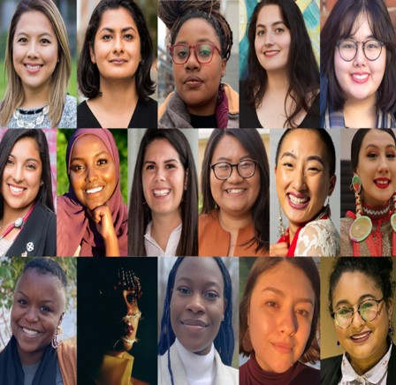
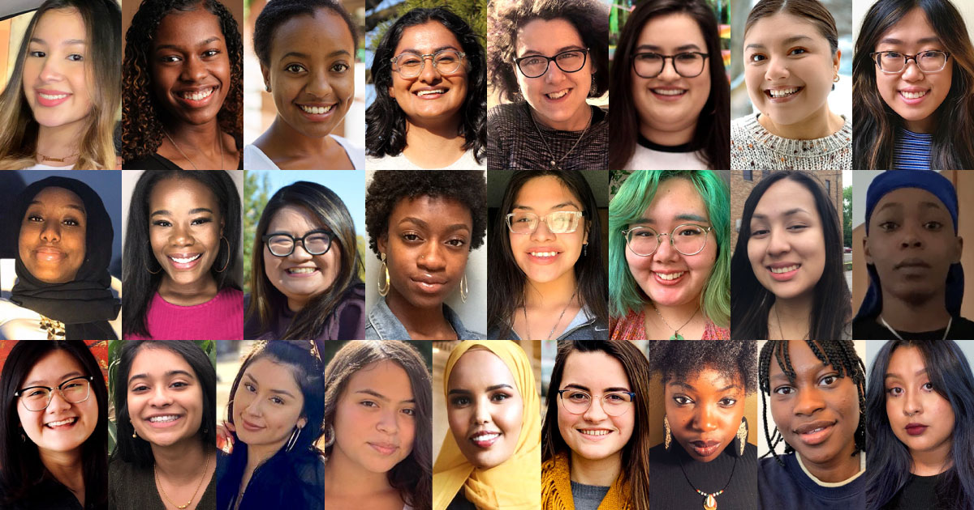
APPLY
tomorrow!
Nov 11th
Thank you!
Notes:
Erika
Apply to become WFMN Innovator Blogpost: https://www.wfmn.org/apply-to-become-a-wfmn-innovator-informational-webinar-is-nov-10/

